Slide 1
Hashing
PRATIMA SARKAR
CSE TINT

Slide 2
Hashing
Hashing refers to the process of generating a fixed-size output from an input of variable size using the mathematical formulas known as hash functions. This technique determines an index or location for the storage of an item in a data structure.
This method is commonly used in databases, caching systems, and various programming applications to optimize search and retrieval operation

Slide 3
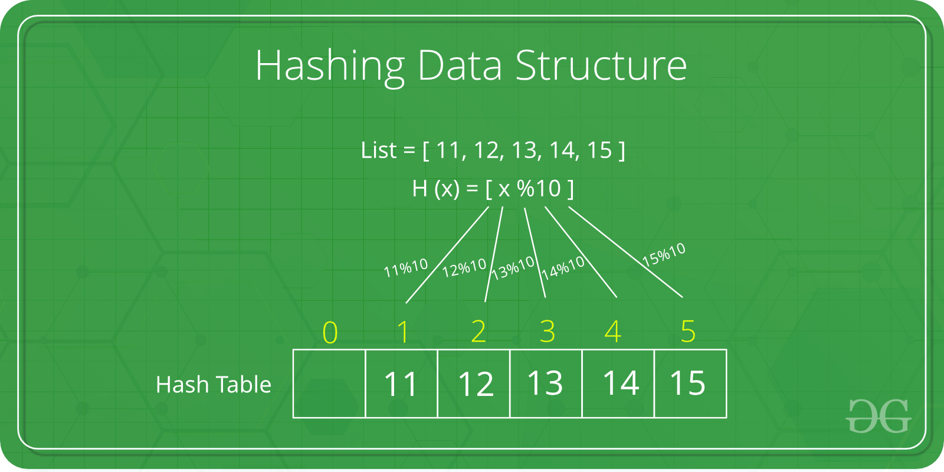

Slide 4
What is Hashing in Data Structure?
Hashing is a technique used in data structures to store and retrieve data efficiently. It involves using a hash function to map data items to a fixed-size array which is called a hash table.
Hash Table in Data Structure
A hash table is also known as a hash map. It is a data structure that stores key-value pairs. It uses a hash function to map keys to a fixed-size array, called a hash table. This allows in faster search, insertion, and deletion operations.

Slide 5
Hash Function
The hash function is a function that takes a key and returns an index into the hash table. The goal of a hash function is to distribute keys evenly across the hash table, minimizing collisions (when two keys map to the same index).
Common hash functions include:
Division Method: Key % Hash Table Size
Multiplication Method: (Key * Constant) % Hash Table Size
Universal Hashing: A family of hash functions designed to minimize collisions

Slide 6
What is a Hash Collision?
A hash collision occurs when two different keys map to the same index in a hash table. This can happen even with a good hash function, especially if the hash table is full or the keys are similar.
Causes of Hash Collisions:
Poor Hash Function: A hash function that does not distribute keys evenly across the hash table can lead to more collisions.
High Load Factor: A high load factor (ratio of keys to hash table size) increases the probability of collisions.
Similar Keys: Keys that are similar in value or structure are more likely to collide.

Slide 7
Components of Hashing
There are majorly three components of hashing:
Key: A Key can be anything string or integer which is fed as input in the hash function the technique that determines an index or location for storage of an item in a data structure.
Hash Function: The hash function receives the input key and returns the index of an element in an array called a hash table. The index is known as the hash index.
Hash Table: Hash table is a data structure that maps keys to values using a special function called a hash function. Hash stores the data in an associative manner in an array where each data value has its own unique index.

Slide 8
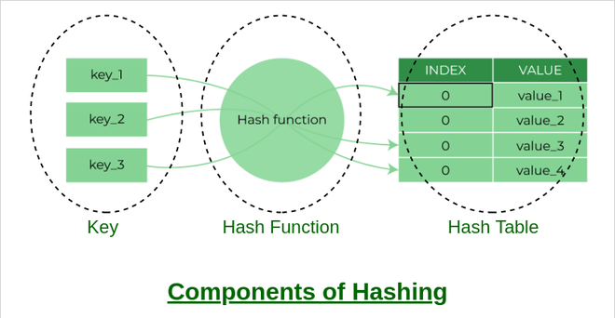

Slide 9
How does Hashing work?
Suppose we have a set of strings {“ab”, “cd”, “efg”} and we would like to store it in a table.
Our main objective here is to search or update the values stored in the table quickly in O(1) time and we are not concerned about the ordering of strings in the table. So the given set of strings can act as a key and the string itself will act as the value of the string but how to store the value corresponding to the key?
Step 1: We know that hash functions (which is some mathematical formula) are used to calculate the hash value which acts as the index of the data structure where the value will be stored.
Step 2: So, let’s assign
“a” = 1,
“b”=2, .. etc, to all alphabetical characters.

Slide 10

How does Hashing work?
Step 3: Therefore, the numerical value by summation of all characters of the string:
“ab” = 1 + 2 = 3,
“cd” = 3 + 4 = 7 ,
“efg” = 5 + 6 + 7 = 18
Step 4: Now, assume that we have a table of size 7 to store these strings. The hash function that is used here is the sum of the characters in key mod Table size. We can compute the location of the string in the array by taking the sum(string) mod 7.
Step 5: So we will then store
“ab” in 3 mod 7 = 3,
“cd” in 7 mod 7 = 0, and
“efg” in 18 mod 7 = 4.

Slide 11
What is a Hash function?
The hash function creates a mapping between key and value, this is done through the use of mathematical formulas known as hash functions. The result of the hash function is referred to as a hash value or hash. The hash value is a representation of the original string of characters but usually smaller than the original.
A good hash function should have the following properties:
Efficiently computable.
Should uniformly distribute the keys (Each table position is equally likely for each.
Should minimize collisions.
Should have a low load factor(number of items in the table divided by the size of the table).

Slide 12
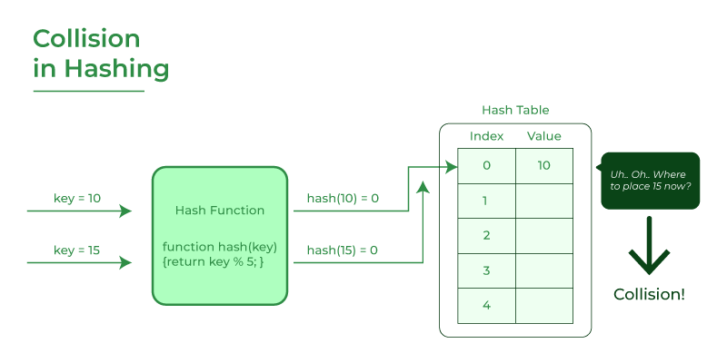
What is collision?
The hashing process generates a small number for a big key, so there is a possibility that two keys could produce the same value. The situation where the newly inserted key maps to an already occupied, and it must be handled using some collision handling technology.

Slide 13
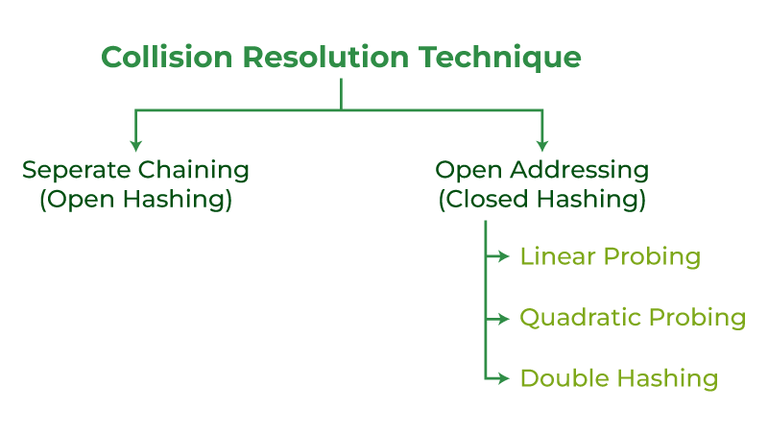
How to handle Collisions?
There are mainly two methods to handle collision:
Separate Chaining
Open Addressing

Slide 14
Separate Chaining
The idea is to make each cell of the hash table point to a linked list of records that have the same hash function value. Chaining is simple but requires additional memory outside the table.
The linked list data structure is used to implement this technique. So what happens is, when multiple elements are hashed into the same slot index, then these elements are inserted into a singly-linked list which is known as a chain.
Let us consider a simple hash function as “key mod 7” and a sequence of keys as 50, 700, 76, 85, 92, 73, 101

Slide 15
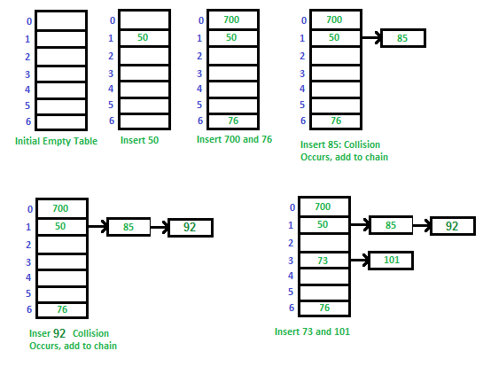

Slide 16
Separate Chaining
Advantages:
Simple to implement.
Hash table never fills up, we can always add more elements to the chain.
Less sensitive to the hash function or load factors.
It is mostly used when it is unknown how many and how frequently keys may be inserted or deleted.
Disadvantages:
The cache performance of chaining is not good as keys are stored using a linked list. Open addressing provides better cache performance as everything is stored in the same table.
Wastage of Space (Some Parts of the hash table are never used)
If the chain becomes long, then search time can become O(n) in the worst case
Uses extra space for links

Slide 17
Performance of Chaining:
m = Number of slots in hash table n = Number of keys to be inserted in hash table
Load factor α = n/m Expected time to search = O(1 + α) Expected time to delete = O(1 + α)
Time to insert = O(1) Time complexity of search insert and delete is O(1) if α is O(1)

Slide 18
open addressing
In open addressing, all elements are stored in the hash table itself. Each table entry contains either a record or NIL. When searching for an element, we examine the table slots one by one until the desired element is found or it is clear that the element is not in the table.
Linear Probing
Quadratic Probing

Slide 19
Linear Probing
In linear probing, the hash table is searched sequentially that starts from the original location of the hash. If in case the location that we get is already occupied, then we check for the next location.
Calculate the hash key. i.e. index= data % size
Check, if hashTable[index] is empty
store the value directly by hashTable[index] = data
If the hash index already has some value then
check for next index using index= (index+1) % size
Check, if the next index is available hashTable[index] then store the value. Otherwise try for next index.
Do the above process till we find the space.

Slide 20
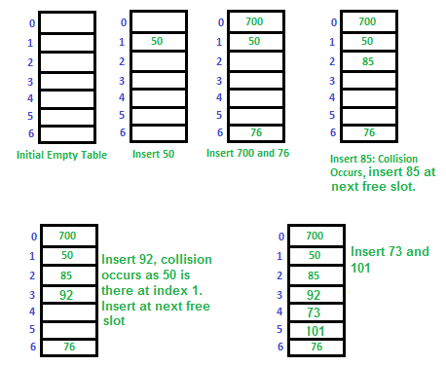

Slide 21
Quadratic probing
Quadratic probing is an open addressing scheme in computer programming for resolving hash collisions in hash tables. Quadratic probing operates by taking the original hash index and adding successive values of an arbitrary quadratic polynomial until an open slot is found.
f the slot hash(x) % n is full, then we try (hash(x) + 1²) % n. If (hash(x) + 1²) % n is also full, then we try (hash(x) + 2²) % n. If (hash(x) + 2²) % n is also full, then we try (hash(x) + 3²) % n. This process will be repeated for all the values of i until an empty slot is found

Slide 22
Quadratic probing
Let us consider table Size = 7, hash function as Hash(x) = x % 7 and collision resolution strategy to be f(i) = i² . Insert = 22, 30, and 50.
Insert 22 and 30Hash(22) = 22 % 7 = 1, Since the cell at index 1 is empty, we can easily insert 22 at slot 1.
Hash(30) = 30 % 7 = 2, Since the cell at index 2 is empty, we can easily insert 30 at slot 2.

Slide 23
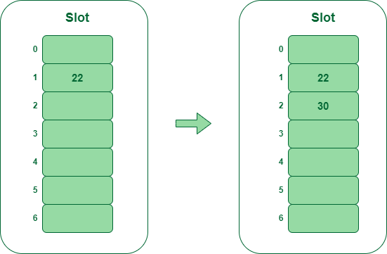
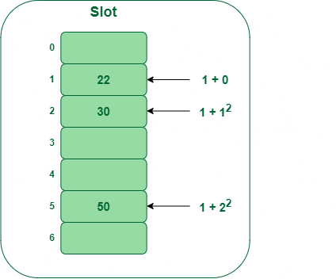
Inserting 50
Hash(50) = 50 % 7 = 1
In our hash table slot 1 is already occupied. So, we will search for slot 1+1², i.e. 1+1 = 2,
Again slot 2 is found occupied, so we will search for cell 1+2², i.e.1+4 = 5,
Now, cell 5 is not occupied so we will place 50 in slot 5.

Slide 24
Double Hashing
Double hashing is a collision resolution technique used in hash tables. It works by using two hash functions to compute two different hash values for a given key. The first hash function is used to compute the initial hash value, and the second hash function is used to compute the step size for the probing sequence.
The advantage of Double hashing is that it is one of the best forms of probing, producing a uniform distribution of records throughout a hash table.

Slide 25
Double Hashing
let hash(x) be the slot index computed using hash function.
If slot hash(x) % S is full, then we try (hash(x) + 1*hash2(x)) % S
If (hash(x) + 1*hash2(x)) % S is also full, then we try (hash(x) + 2*hash2(x)) % S
If (hash(x) + 2*hash2(x)) % S is also full, then we try (hash(x) + 3*hash2(x)) % S

Slide 26
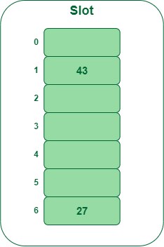
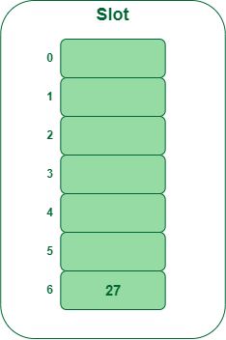
Double Hashing
Insert the keys 27, 43, 692, 72 into the Hash Table of size 7. where first hash-function is h1​(k) = k mod 7 and second hash-function is h2(k) = 1 + (k mod 5)

Slide 27
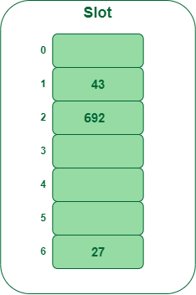
Double Hashing
Insert 692692 % 7 = 6, but location 6 is already being occupied and this is a collision
So we need to resolve this collision using double hashing.
h_{new} = [h1(692) + i * (h2(692)] % 7 = [6 + 1 * (1 + 692 % 5)] % 7 = 9% 7 = 2
Now, as 2 is an empty slot, so we can insert 692 into 2nd slot.

Slide 28
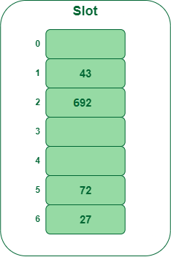
Double Hashing
Insert 7272 % 7 = 2, but location 2 is already being occupied and this is a collision.
So we need to resolve this collision using double hashing.
h_{new} = [h1(72) + i * (h2(72)] % 7 = [2 + 1 * (1 + 72 % 5)] % 7 = 5 % 7 = 5,
Now, as 5 is an empty slot, so we can insert 72 into 5th slot.

Slide 29
Thank You

